Slide 1
統計學一上 Chapter 3: Graphical Descriptive Techniques II
Sep. 27, 2017
By
Ching-Chin Chern

Slide 2
Agenda
Techniques to Describe a Set of Interval Data
Describing Time-Series Data
Describing the Relationship between Two Interval Variables
Art and Science of Graphical Presentations

Slide 3
Data Based on Time
Data can be classified according to the time it is collected.
Cross-sectional data are all collected at the same time.
Time-series data are collected at successive points in time.

Slide 4
Examples (Time-series or Not)

Marketing survey (observe preferences by gender, age)

Weekly closing price of gold

Test score in a statistics course

Amount of crude oil imported monthly

Starting salaries of an MBA program graduates

Slide 5
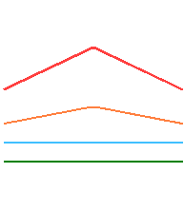
Describing Time-Series Data
Time-series data is often depicted on a line chart (a plot of the variable over time).
Plot the frequency of a category above the point on the horizontal axis representing time

Slide 6
Line Chart
Total number of new products introduced in North America in the years 1989,…,1994
20,000
15,000
10,000
Line charts are particularly useful when trend over time is to be emphasized.
5,000
0
‘89 ‘90 ‘91 ‘92 ‘93 ‘94

Slide 7
The Bar and Line Charts
Use bar charts also when the order in which nominal data are presented is meaningful.
Total number of new products introduced in North America in the years 1989,…,1994
20,000
15,000
10,000
5,000
0
‘89 ‘90 ‘91 ‘92 ‘93 ‘94

Slide 8
Example
We recorded the monthly average retail price of gasoline since 1976. Draw a line chart to describe these data and briefly describe the results.

Slide 9
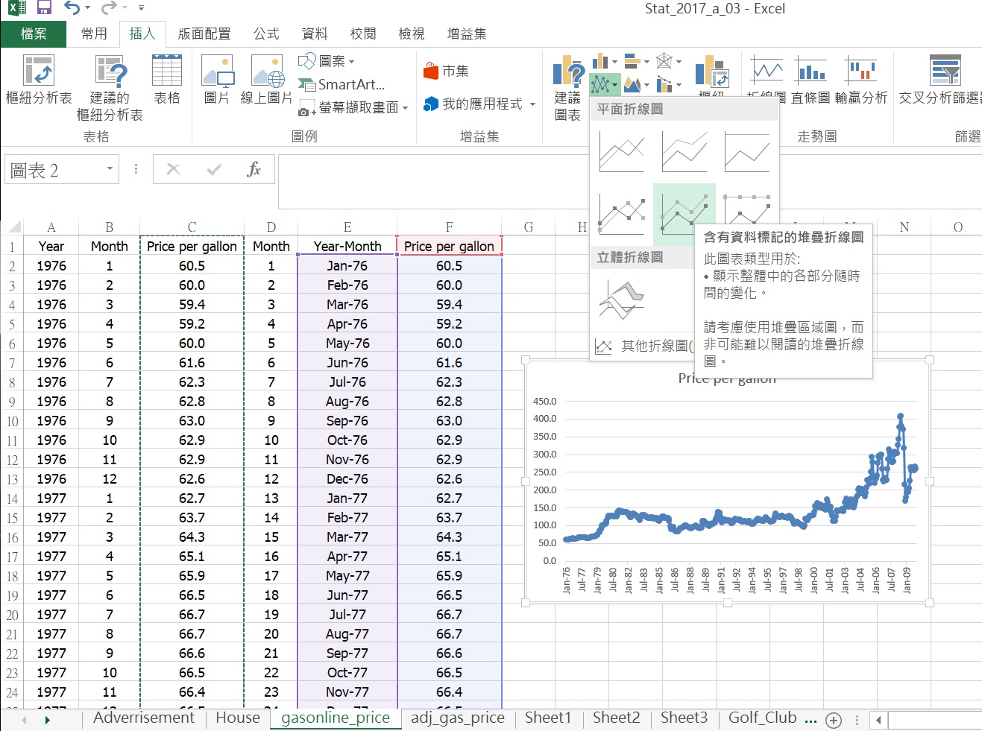
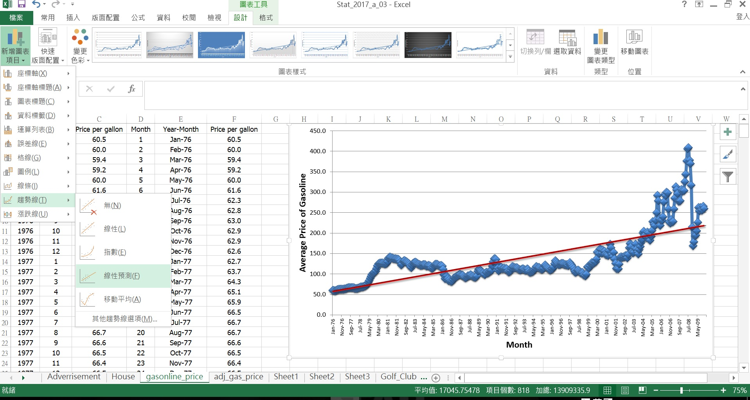
Excel Output

Slide 10
Line Chart
There is a long-term increasing trend in the monthly average retail price of gasoline since 1976

Slide 11
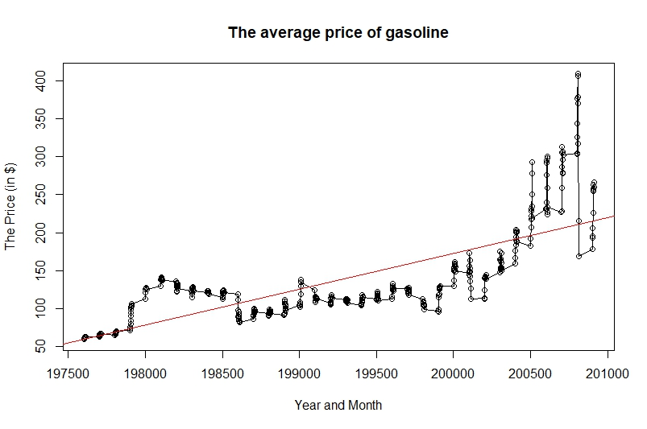
R Code for Line Chart
fileXls = "gasoline_example.xlsx"
gas_data <- loadWorkbook(fileXls)
gas_price <- readWorksheet(gas_data,1)
year <- gas_price$Year
month <- gas_price$Month
Price_per_gallon <- gas_price$Price_per_gallon
n <- length(Price_per_gallon)
year_month <- year*100 + month
plot(year_month, Price_per_gallon, main = "The average price of gasoline", xlab = "Year and Month", ylab = "The Price (in $)")
lines(year_month, Price_per_gallon)
abline(lm(Price_per_gallon ~ year_month), col= "red")
library(rJava)
library(XLConnect)
library(lmtest)
library(tseries)
library(snpar)
library(vcd)
library(MASS)

Slide 12
Removing the Effect of Inflation
Remove the effect of inflation in the monthly average retail price of gasoline to determine whether gasoline prices are higher than they have been in the past after removing the effect of inflation.

Slide 13
Adjusted Line Chart
There is a long-term decreasing trend in the monthly average retail price of gasoline since 1976 after adjusted by inflation effect

Slide 14
Interpretation
Using constant 1982-1984 dollars, we can see that the average price of a gallon of gasoline hit its peak in the middle of 2008 (month 390). From there it dropped rapidly and in late 2009 it was about equal to the adjusted price in 1976.

Slide 15
Agenda
Techniques to Describe a Set of Interval Data
Describing Time-Series Data
Describing the Relationship between Two Interval Variables
Art and Science of Graphical Presentations

Slide 16
Scatter Diagram
Show the relationships between two interval variables, e.g., linear vs. nonlinear, positive related vs. negative related

Slide 17
Example
A small business owner wants to assess the effects of advertising on sales levels. Paired observation data were collected. Each pair consisted of monthly advertising expenditure and monthly sales levels.

Slide 18
The Data
All numbers here are in $1000s.

Slide 19
Scatter Diagram
Sales
Excel scatter diagram
Advertising expenditure and sales
have “positive relationship”
Advertising expenditure and sales
appear to have “linear” relationship
Advertising Expenditure

Slide 20
Example
A real estate agent wants to study the relationship between house price and house size
Use graphical technique to describe the relationship between size and price.

Slide 21
Data
Twelve houses recently sold are sampled and there size and price recorded
Size Price
23 315
18 229
26 335
20 261
22 234
……………..
……………..

Slide 22
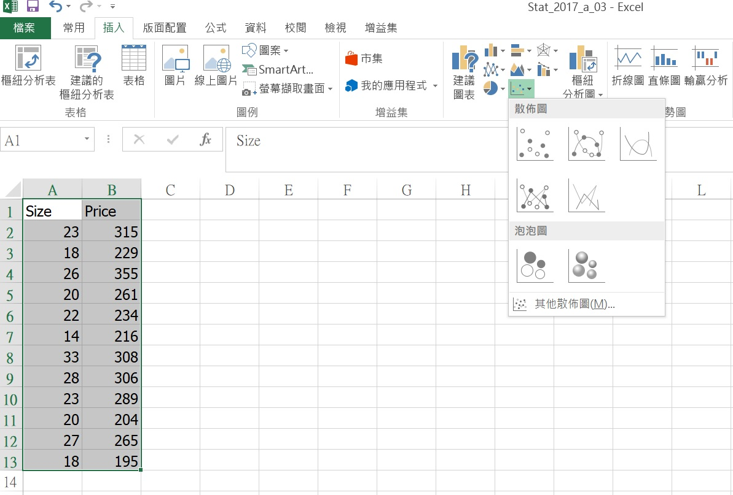
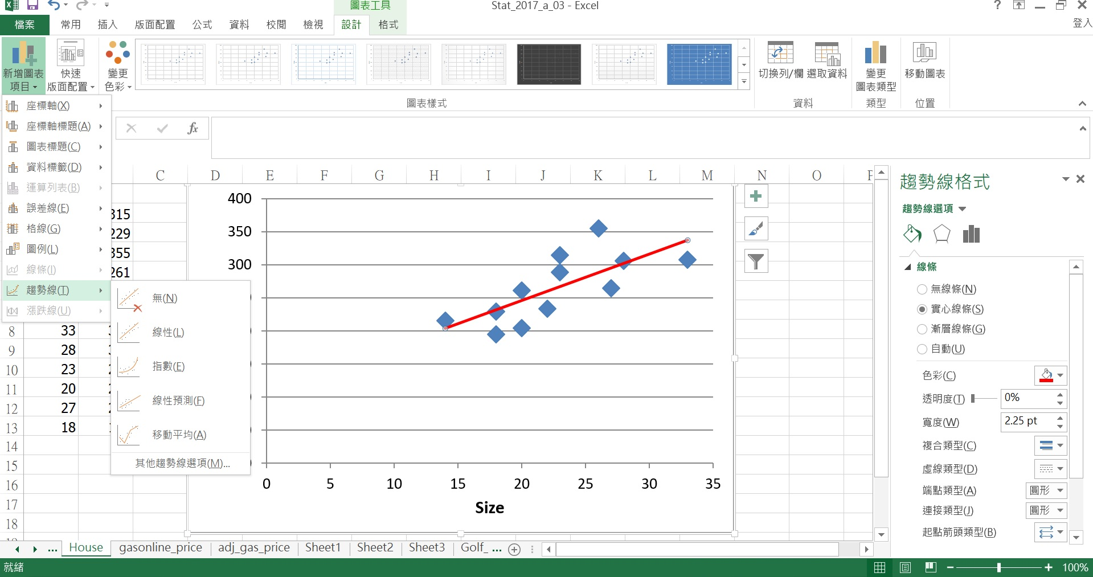
Excel Output

Slide 23
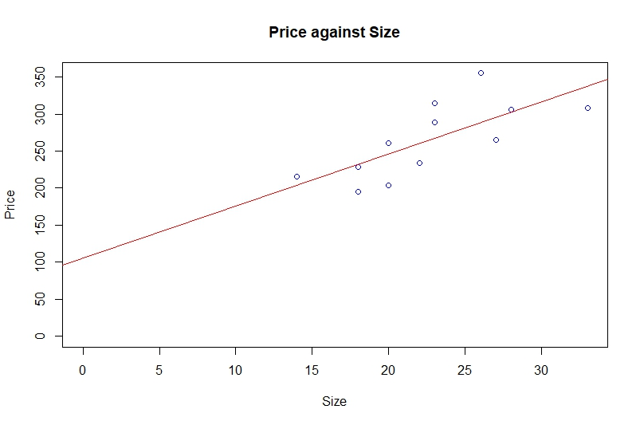
R Code for Scatter Diagram
library(rJava)
library(XLConnect)
library(lmtest)
library(tseries)
library(snpar)
library(vcd)
library(MASS)
fileXls = "house_price_example.xlsx"
house_data <- loadWorkbook(fileXls)
house_price <- readWorksheet(house_data,1)
size <- house_price$Size
price <- house_price$Price
n <- length(price)
plot(size, price, col = "blue", main = "Price against Size", xlab = "Size", ylab = "Price", xlim=range(0, size), ylim=range(0, price))
abline(lm(price ~ size), col= "red")

Slide 24
Scatter Diagram
The house size (variable X) affects the house price (variable Y)
The larger the house size,
the higher the price (positive)
Y
Linear relationship exists
X

Slide 25
Typical Patterns
Positive linear
relationship
Negative linear
relationship
No relationship
Negative nonlinear
relationship
Nonlinear (concave)
relationship
This is a possible
relationship, but
doesn’t the next
one appear to
fit the data better?

Slide 26
Summary
 | Interval Data | Nominal Data
Single Set of Data | Histogram, Ogive, or Stem-and-Leaf Display | Frequency and Relative Frequency Tables, Bar and Pie Charts
Relationship Between Two Variables | Scatter Diagram Line Chart | Contingency Table, Bar Charts

Slide 27
Agenda
Techniques to Describe a Set of Interval Data
Describing Time-Series Data
Describing the Relationship between Two Interval Variables
Art and Science of Graphical Presentations

Slide 28

Make it Fun and Knowledgeable
?

Slide 29
Effective Graphical Techniques
“Graphical Excellence” deals with the effective use of graphical techniques.
Concise and Coherently
Clear Communication
Encourage Comparison
See the Substance of the Data
No Distortion

Slide 30
Graphical Deception
Things to be cautious about when observing a graph:
Is there a missing scale?
Do not be influenced by a graph’s caption.
Are changes presented in absolute values only, or in percent form too.
Stretching the axis

Slide 31
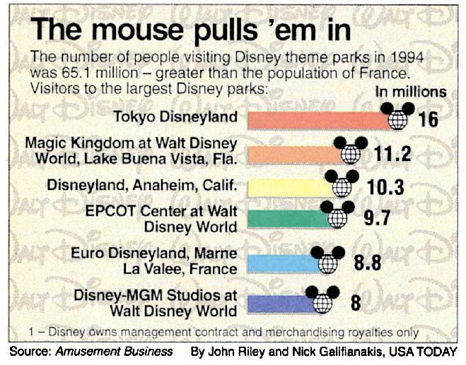
Unnecessary Chart
Graphical techniques should be used when there is a large amount of data
28.9
This bar chart is completely unnecessary:
Only six numbers are represented.
No analysis associated with the data.

Slide 32
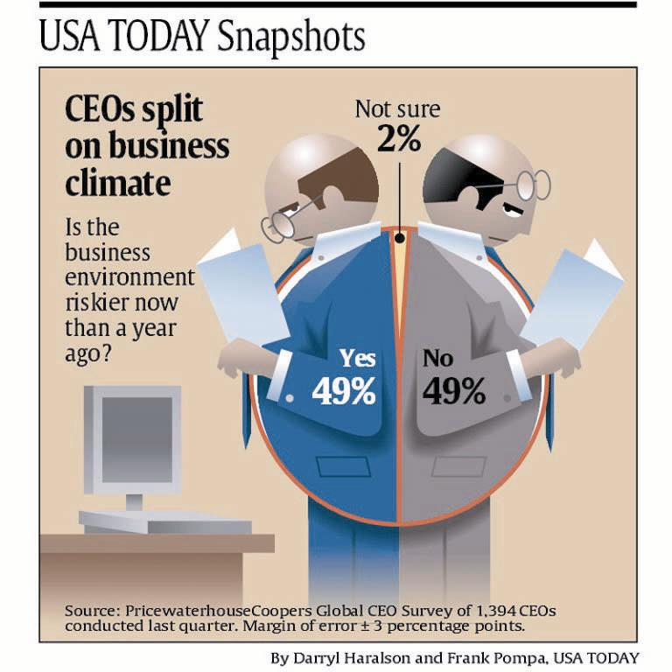
Chartjunk
Design overcome the substance.
Contain very little data (3 numbers)
The idea is not clear (no idea to impart.)
No analysis associated with the chart.

Slide 33
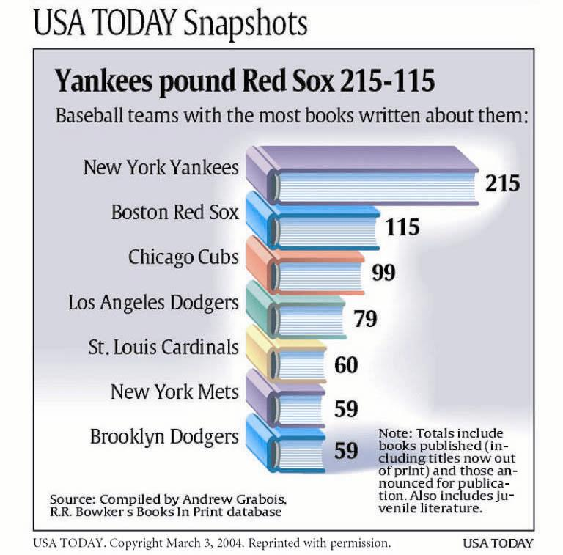
Substance Problem
This is a chart that contains only 7 numbers
It’s about baseball teams not books
Here a table would easily suffice.

Slide 34
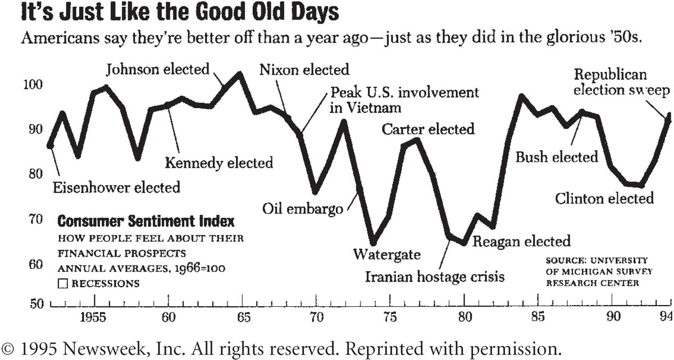
A Short Story
Provides rich details about the factors that affect American’s perceptions of their financial circumstances

Slide 35
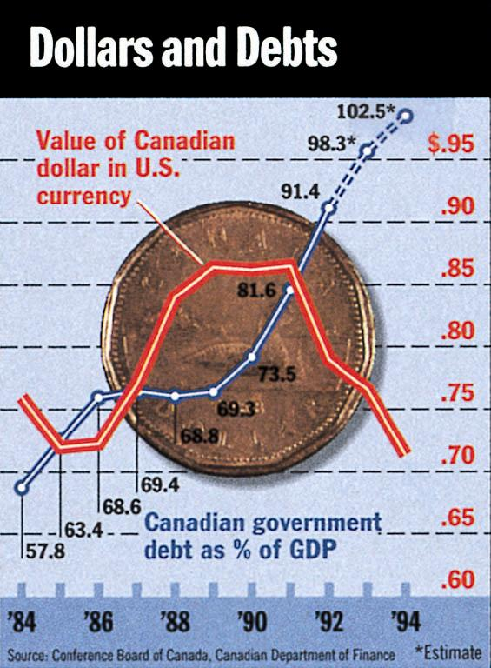
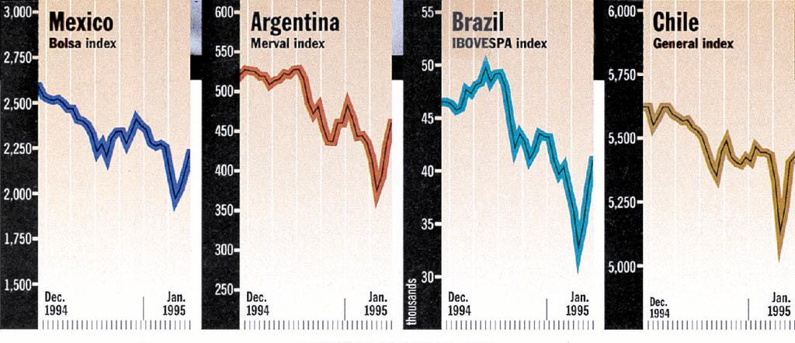
Good Examples
Well Designed, presenting interesting data, imparting data concisely, and no distortion.
Sources: both from 1995 Time Magazine

Slide 36
Minard’s Famous Napoleonic Chart…
Many consider Charles Joseph Minard’s original time series chart (Figure 3.13 on Page 82) to be the best statistical graphic ever drawn. Why?

Slide 37
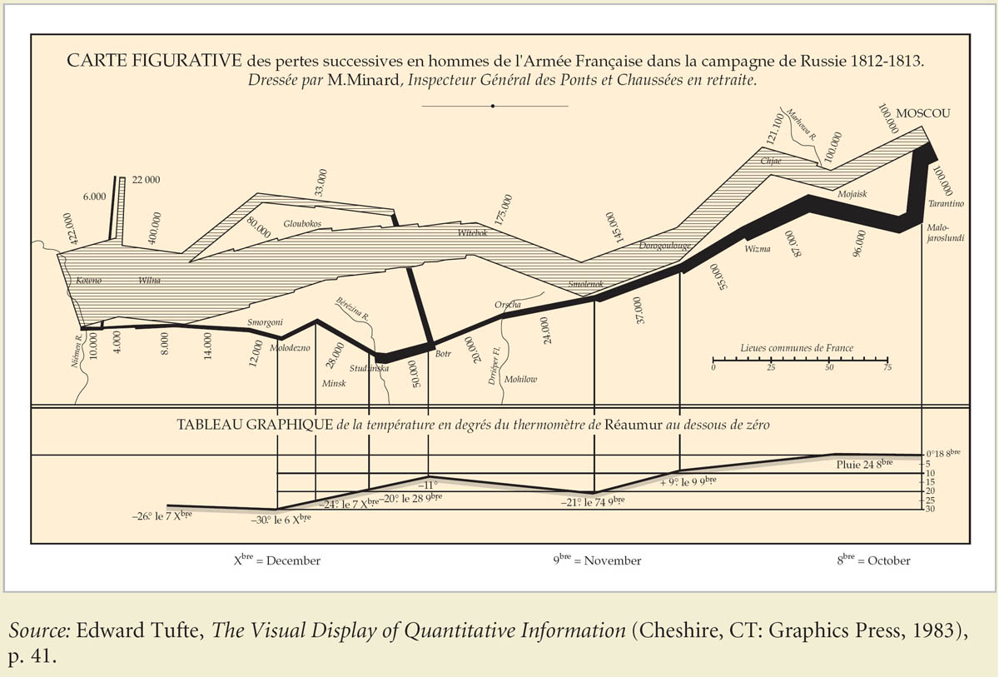
Napoleonic Chart (p. 82)

Slide 38
End of Chapter 3 Part B

Slide 39
Chapter 4 : Numerical Descriptive Techniques

Slide 40
Purpose of Using Numerical Descriptive Techniques
Usually, we focus our attention on several types of measures when describing population or sample characteristics such as Central Location (e.g. Average) and Variability or Spread

Slide 41
Numerical Descriptive Techniques
For one variable:
Central Location
Variability
Relative Standing
For two variables: Relationship between two variables
Mostly for interval data type.

Slide 42
Agenda
Measures of Central Location
Measures of Variability
Measures of Relative Standing
Measures of Linear Relationship

Slide 43
Measures of Central Location
The central data point reflects the gravity center (the core, the focus, the key point) of all the actual data points.
Arithmetic Mean
Median
Mode (Modal Class)
Geometric Mean

Slide 44
Arithmetic Mean
This is the most popular and useful measure of central location
Average or Expected Value
For interval data type
This is seriously affected by extreme values

Slide 45
Arithmetic Mean
Sum of the measurements
Number of measurements
Mean =
Sample mean
Population mean
Sample size
Population size

Slide 46
Example 1
The mean of the sample of six measurements
7, 3, 9, -2, 4, 6 is given by
7
3
9
– 2
4
6
4.5

Slide 47
Example 2
Suppose the telephone bills represent population of measurements. The population mean is
42.19
15.30
53.21
43.59

Slide 48
Example 3
When many of the measurements have the same value, the measurement can be summarized in a frequency table. Suppose the number of children in a sample of 16 employees were recorded as follows:
NUMBER OF CHILDREN 0 1 2 3
NUMBER OF EMPLOYEES 3 4 7 2

Slide 49
Computation of the Arithmetic Mean
NUMBER OF CHILDREN 0 1 2 3
NUMBER OF EMPLOYEES 3 4 7 2
16 employees
Arithmetic Mean is not a realistic number.

Slide 50
Measures of Central Location
The central data point reflects the gravity center (the core, the focus, the key point) of all the actual data points.
Arithmetic Mean
Median
Mode (Modal Class)
Geometric Mean

Slide 51
The Median
The value that falls in the middle when the measurements are arranged in order of magnitude.
There is a little difference in computing the median between odd and even numbers of observations.
For interval or ordinal data types

Slide 52
Example 1
Seven employee salaries were recorded (in 1000s): 28, 60, 26, 32, 30, 26, 29. Find the median.
First, sort the salaries.
Then, locate the value in the middle
Odd number of observations
26,26,28,29,30,32,60
26,26,28,29,30,32,60

Slide 53
Example 2
Suppose one employee’s salary of $31,000 was added to the group recorded before. Find the median.
First, sort the salaries.
Then, locate the values in the middle
Even number of observations
The number does not exist in the original data set.
There are two middle values!
26,26,28,29, 30,31,32,60
26,26,28,29,30,31,32,60
26,26,28,29, 30,31,32,60
26,26,28,29, 30,31,32,60
29.5,

Slide 54
Measures of Central Location
The central data point reflects the gravity center (the core, the focus, the key point) of all the actual data points.
Arithmetic Mean
Median
Mode (Modal Class)
Geometric Mean

Slide 55
The Mode
The value that occurs most frequently.
Set of data may have one mode (or modal class, unimodal), or two or more modes (bimodal or multi-modal).
For all data types

Slide 56
Example
The manager of a men’s store observes the waist size (in inches) of trousers sold yesterday: 31, 34, 36, 33, 28, 34, 30, 34, 32, 40.
The mode of this data set is 34 in.
This information seems valuable (for example, for the design of a new display in the store), much more than “the mean = 33.2 in” or “the median = 33.5 in”.

Slide 57
Example
Find the mode for the following data set: 0, 7, 12, 5, 33, 14, 8, 0, 9, 22.
All observation except “0” occur once. There are two “0”. Thus, the mode is zero.

Slide 58
Question?
Is this a good measure of central location?
The value “0” does not reside at the center of this set (compare with the mean = 11.0 and the median = 8.5).

Slide 59
The Modal Class
The modal class
For large data sets the modal class is much more relevant than the a single-value mode.

Slide 60
Relationship among Mean, Median, and Mode
If a distribution is symmetrical and unimodal, the mean, median and mode coincide
Median
Mean
Mode

Slide 61
Positively Skewed
If a distribution is nonsymmetrical, and skewed to to the right, the three measures differ.
A positively skewed distribution
(“skewed to the right”)
Mode
Mean
Median

Slide 62
Negatively Skewed
If a distribution is nonsymmetrical, and skewed to the left or to the right, the three measures differ.
A negatively skewed distribution
(“skewed to the left”)
Mean
Mode
Median

Slide 63
Example
A professor of statistics wants to report the results of a midterm exam, taken by 100 students. Find the mean, median, and mode, and describe the information they provide.

Slide 64
Excel Output
The mode must be used when data is qualitative. If marks are classified by letter grade, the frequency of each grade can be calculated. Then, the mode becomes a logical measure to compute.
The mean provides
information about the
over-all performance level of the class. It can serve as a tool for making comparisons with other classes and/or other exams.
The Median indicates that
half of the class received a grade below 81, and
half of the class received a grade above 81.

Slide 65
Excel Histogram
The histogram is skewed to the left
Modal class

Slide 66
Mean, Median, and Mode
A professor of statistics wants to report the results of a midterm exam, taken by 100 students.
The mean of the test marks is 73.90
The median of the test marks is 81
The mode of the test marks is 84

Slide 67
Mean Median and Mode
The histogram is skewed to the left
Mean
Mode
Median

Slide 68
Measures of Central Location
The central data point reflects the gravity center (the core, the focus, the key point) of all the actual data points.
Arithmetic Mean
Median
Mode (Modal Class)
Geometric Mean

Slide 69
The Geometric Mean
This is a measure of the average growth rate, or rate of change (such as the value of an investment), in a variable over time.

Slide 70
Example
Suppose you make a 2-year investment of $1000, and it grows by 100% to $2000 during the first year. During the second year, however, the investment declines by 50% from $2000 back to $1000.
=>[100%+(-50%)]/2 = 25%

Slide 71
The Truth
25% is arithmetic mean return and is misleading.
There was no change in the value of the investment at the end of the two periods. The average compounded return over the two periods was actually 0%.
=> Geometric mean.

Slide 72
The Geometric Mean
Let R_{i} denote the the rate of return in period i (i=1,2…,n). The geometric mean of the returns R₁, R₂, …, R_{n} is the constant R_{g} that produces the same terminal wealth at the end of period n as do the actual returns for the n periods.

Slide 73
The Geometric Mean
R_{g} is selected such that the n-period returns calculated by both methods are equal.
For the given series of rate
Of returns the n-period
return is calculated by
If the rate of return was R_{g} in every period, the n-period return would be
=

Slide 74
Example
Suppose you make a 2-year investment of $1000, and it grows by 100% to $2000 during the first year. During the second year, however, the investment declines by 50% from $2000 back to $1000.
(1+100%)(1-50%)
= 0%

Slide 75
Example
A firm’s sales were $1000000 three years ago. Sales have grown annually by 20%, 10%, -5%.
(1) Find the geometric mean rate of growth in sales.
(2) Find the sales at the end of last year.

Slide 76
Solution
(1) Since R_{g} is the geometric mean
(1 + R_{g})³=(1+.2)(1+.1)(1-.05)= 1.2540
(2) The sales at the end of last year
$1,000,000* (1 + R_{g})³ = $1,000,000*(1 + 7.84%)³ = 1,254,000

Slide 77
Agenda
Measures of Central Location
Measures of Variability
Measures of Relative Standing
Measures of Linear Relationship

Slide 78
Reason for Measures of Variability
Look beyond the Average
Measures of Central Location fail to tell the whole story about the distribution.

Slide 79
Why Variability?
A question of interest still remains unanswered:
How typical is the average value of all the measurements in the data set?
or
How much spread out are the measurements about the average value?

Slide 80
Observe Two Data Sets
The average value
provides a good
representation of the
values in the data set
Low variability
data set
The same average
value does not provide
as good presentation of
the values in the data
set as before.
High variability
data set

Slide 81
Measures of Variability
Range
Variance
Standard Deviation
Coefficient of Variation

Slide 82
The Range
The difference between the largest and smallest measurements or observations.
Tell us how far the data spread out.

Slide 83
Example
Seven employee salaries were recorded (in 1000s): 28, 60, 26, 32, 30, 26, 29. Find the range.
First, identify the smallest and largest observations.
Then, compute range = 60-26 = 34
26,26,28,29,30,32,60

Slide 84
The Range
But, how do all the
measurements spread out?
The range cannot assist in answering this question
?
?
?
Range
Smallest
measurement
Largest
measurement

Slide 85
The Usage of Range
Its major advantage is the ease with which it can be computed.
Its major shortcoming is its failure to provide information on the dispersion of the values between the two end points.

Slide 86
Measures of Variability
Range
Variance
Standard Deviation
Coefficient of Variation

Slide 87
The Variance
One of the most widely accepted measures of the variability of a set of quantitative data.
Observe the difference between each value and the mean.
This measure of dispersion reflects the values of all the measurements.

Slide 88
Large vs. Small Variations
Consider two small populations:
Population A: 8, 9, 10, 11, 12
Population B: 4, 7, 10, 13, 16
Thus, a measure of dispersion is needed that agrees with this observation.
A
8
9
10
11
12
…but measurements in B are much more dispersed then those in A.
The mean of both
populations is 10...
B
4
7
10
13
16

Slide 89
Why Not Just Sum?
9 -10 = -1
Consider two small populations:
Population A: 8, 9, 10, 11, 12
Population B: 4, 7, 10, 13, 16
11-10 = +1
8 -10 = -2
12 -10 = +2
Sum = 0
Let us start by calculating
the sum of deviations
The sum of deviations
is zero in both cases,
therefore, another
measure is needed.
A
8
9
10
11
12
4 -10 = - 6
The mean of both
populations is 10...
16 -10 = +6
B
7 -10 = -3
13 -10 = +3
4
7
10
13
16
Sum = 0

Slide 90
Squared Sum
The sum of squared deviations is used in calculating the variance.
9-10= -1
11-10= +1
8-10= -2
12-10= +2
Sum = 0
The sum of deviations is zero in both cases,
therefore, another
measure is needed.
A
8
9
10
11
12
4-10 = - 6
B
16-10 = +6
7-10 = -3
4
7
10
13
16
13-10 = +3
Sum = 0

Slide 91
Why Average of Squared Deviation?
Why is the variance defined as the average squared deviation? Why not use the sum of squared deviations as a measure of dispersion instead?
After all, the sum of squared deviations increases in magnitude when the dispersion of a data set increases!!

Slide 92
The Population Variance
The variance of a population of N measurements x₁, x₂,…,x_{N} having a mean μ is defined as

Slide 93
Variances
Let us calculate the variance
of the two populations

Slide 94
The Sample Variance
The variance of a sample of n measurements x₁, x₂, …,x_{n} having a mean is defined as

Slide 95
Example
The following sample consists of the number of jobs six students applied for: 17, 15, 23, 7, 9, 13. Finds its mean and variance

Slide 96
The Variance–Shortcut Method

Slide 97
Measures of Variability
Range
Variance
Standard Deviation
Coefficient of Variation

Slide 98
Computation of Standard Deviation
The standard deviation of a set of measurements is the square root of the variance of the measurements.

Slide 99
Why Standard Deviation?
Variance: squaring the original observations => Square the unit
e.g., variance of minutes => minute squared, variance of dollars => dollar squared
Goal: the measure of variability is expressed in the same unit as the original observations

Slide 100
Example
The following sample consists of the number of jobs six students applied for: 17, 15, 23, 7, 9, 13. Finds its standard deviation.
=> s = √33.2 = 5.7619 jobs

Slide 101
Example
To examine the consistency of shots for a new innovative golf club, a golfer was asked to hit 150 shots, 75 with a currently used (7-iron) club, and 75 with the new club. The distances were recorded. Which 7-iron is more consistent?

Slide 102
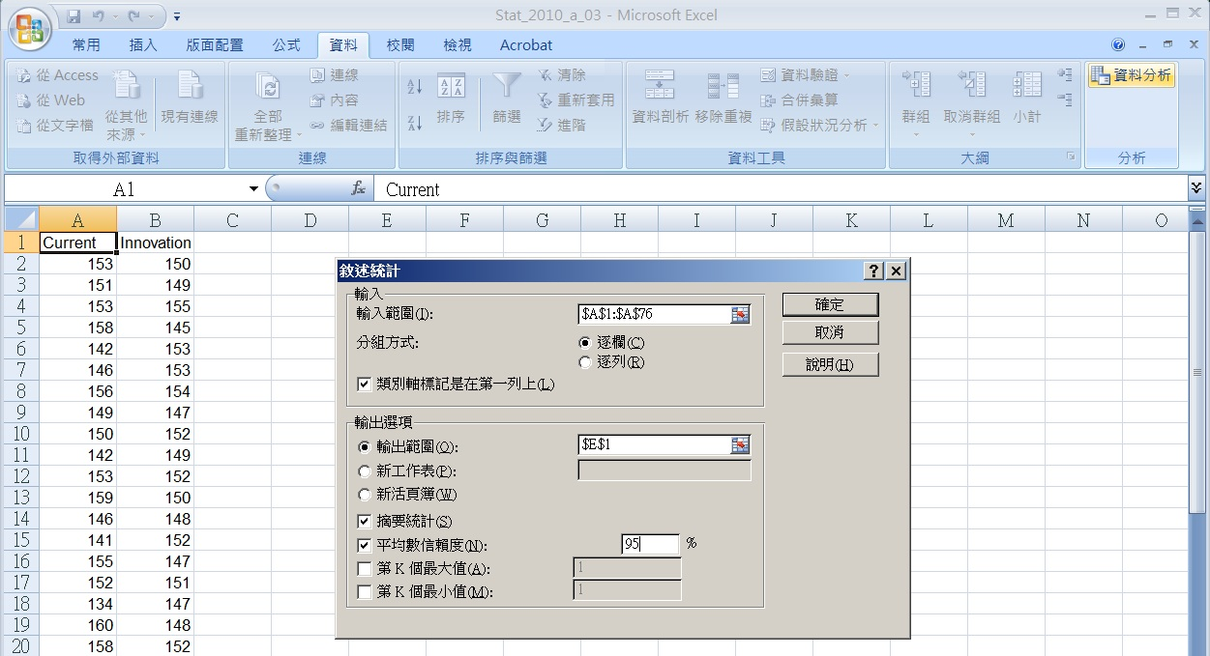
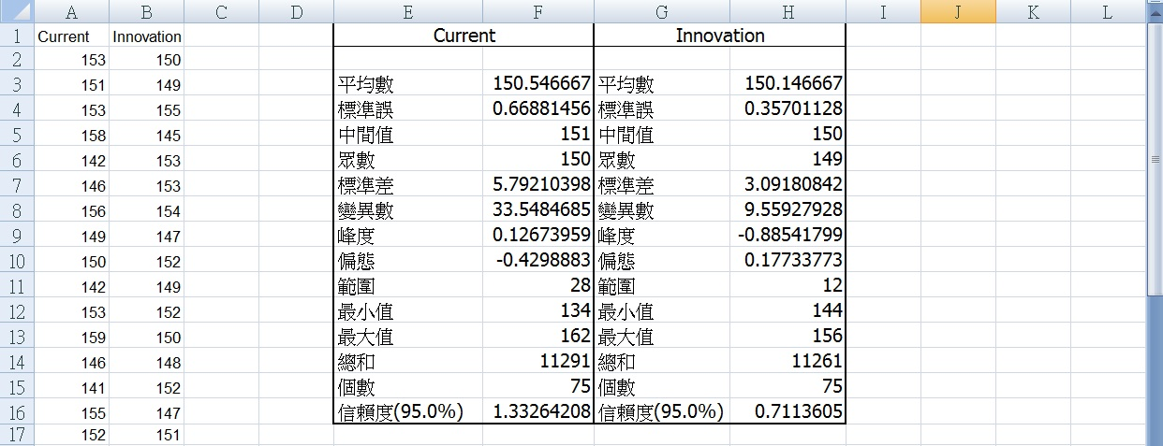
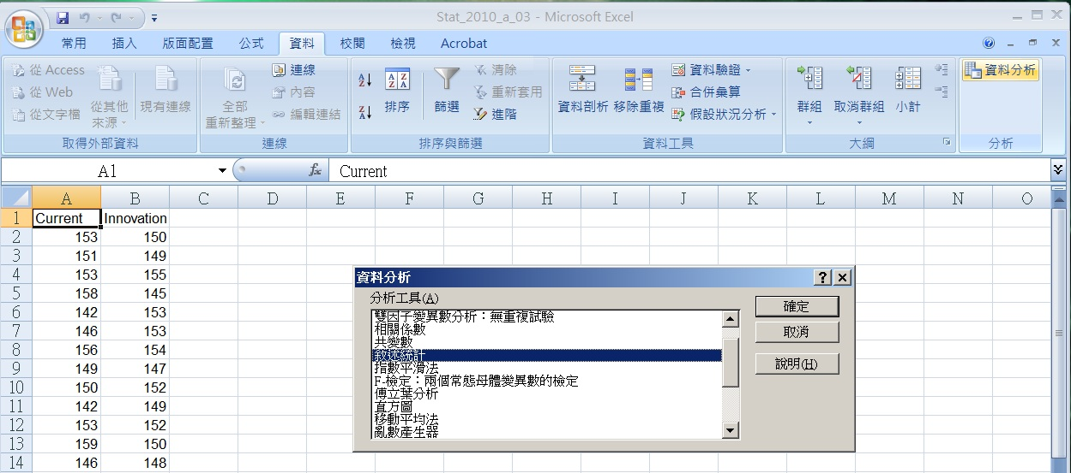
Excel Setup

Slide 103
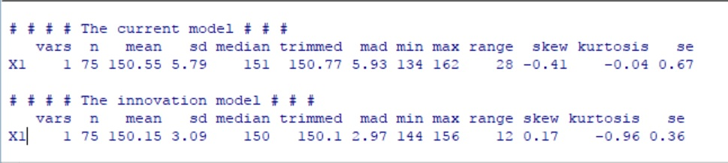
R Code for Descriptive Statistics
library(rJava)
library(XLConnect)
library(lmtest)
library(tseries)
library(snpar)
library(vcd)
library(MASS)
library(psych)
fileXls = "Gulf_Club.xlsx"
GC_data <- loadWorkbook(fileXls)
GC_CI <- readWorksheet(GC_data,1)
Current <- GC_CI$Current
Innovation <- GC_CI$Innovation
n <- length(Current)
cat("# # # # The current model # # # ","\n")
print(describe(Current))
cat(" ","\n")
cat("# # # # The innovation model # # # ","\n")
print(describe(Innovation))

Slide 104
Excel Output
The innovation club is more consistent, and because the means are close, is considered a better club

Slide 105
Example
Rates of return over the past 10 years for two mutual funds are shown below. Which one have a higher level of risk?
Fund A: 8.3, -6.2, 20.9, -2.7, 33.6, 42.9, 24.4, 5.2, 3.1, 30.05
Fund B: 12.1, -2.8, 6.4, 12.2, 27.8, 25.3, 18.2, 10.7, -1.3, 11.4

Slide 106
Excel Output
Though fund A is more profitable, fund A should be considered riskier because its standard deviation is larger.

Slide 107
Usage of Standard Deviation
Compare the variability of several distributions
Make a statement about the general shape of a distribution.

Slide 108
The Empirical Rule 1/2
If a sample of measurements has a mound-shaped (bell-shaped) distribution, the interval
contains approximately 68% of the measurements
contains approximately 95% of the measurements
contains virtually all of the measurements

Slide 109
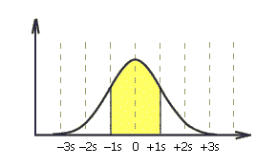
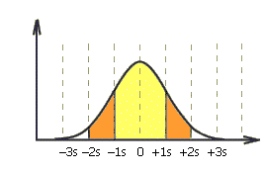

The Empirical Rule 2/2
Approximately 68% of all observations fall within one standard deviation of the mean.
Approximately 95% of all observations fall within two standard deviations of the mean.
Approximately 99.7% of all observations fall within three standard deviations of the mean.

Slide 110
Example
A statistics practitioner wants to describe the way returns on investment are distributed.
The mean return = 10%
The standard deviation of the return = 8%
The histogram is bell shaped.

Slide 111
Applying Empirical Rule
Approximately 68% of the returns lie between 2% and 18%, or [10 – 1(8), 10 + 1(8)]%
Approximately 95% of the returns lie between -6% and 26%, or [10 – 2(8), 10 + 2(8)]%
Approximately 99.7% of the returns lie between -14% and 34%, or [10 – 3(8), 10 + 3(8)]%

Slide 112
Graphical Expression
Approximately 68% of all observations fall within one standard deviation of the mean.
2% 10% 18%
Approximately 95% of all observations fall within two standard deviations of the mean.
-6% 2% 10% 18% 26%
Approximately 99.7% of all observations fall within three standard deviations of the mean.
-14% -6% 2% 10% 18% 26% 34%

Slide 113
Example
The duration of 30 long-distance telephone calls are shown below. Check the empirical rule for the this set of measurements.

Slide 114
Bell Shape Histogram

Slide 115
Use Empirical Rule
Mean = 10.26; Standard Deviation = 4.29.
Calculate the intervals:
Interval Empirical Rule Actual percentage
(5.97, 14.55) 68% 70%
(1.68, 18.84) 95% 96.7%
(-2.61, 23.13) 100% 100%

Slide 116
Reverse Computation
Since about 95% of all the measurements fall within two standard deviation around the mean
For the telephone calls duration problem the range is 19.5-2.3 = 17.2 minutes.
s = 4.29 minutes

Slide 117
The Chebyshev Theorem
Given any set of measurements and a number k (not smaller than 1), the fraction of these measurements that lie within k standard deviations around the mean is at least .

Slide 118
The Chebyshev Theorem
This theorem is valid for any set of measurements (sample, population) of any shape.
K Interval Chebyshev Empirical Rule
1
2
3
at least 0% approximately 68%
1-1/1²=0
at least 75% approximately 95%
1-1/2²=3/4
at least 89% approximately 100%
1-1/3²=8/9

Slide 119
Example
The annual salaries of the employees of a chain of computer stores produced a positively skewed histogram. The mean and standard deviation are $28,000 and $3,000, respectively. What can you say about the salaries at this chain?

Slide 120
Apply Chebyshev
At least 75% of the salaries lie between $22,000 and $34,000, or [28000 – 2(3000), 28000 + 2(3000)]
At least 88.9% of the salaries lie between $19,000 and $37,000, or [28000 – 3(3000), 28000 + 3(3000)]

Slide 121
Chebyshev Theorem
Positively skewed
19000
22000
28000
34000
37000
75%
88.9%

Slide 122
Example
The duration of 30 long-distance telephone calls are shown below. Check the empirical rule for the this set of measurements.

Slide 123
Apply Chebyshev
Mean = 10.26; Standard deviation = 4.29.
Calculate the intervals:
Interval Chebyshev Empirical Rule Actual %
(5.97, 14.55) at least 0% 68% 70%
(1.68, 18.84) at least 75% 95% 96.7%
(-2.61, 23.13) at least 89% 100% 100%

Slide 124
Example
Providing information concerning the monthly bills of new subscribers in the first month after signing on with a telephone company.

Slide 125
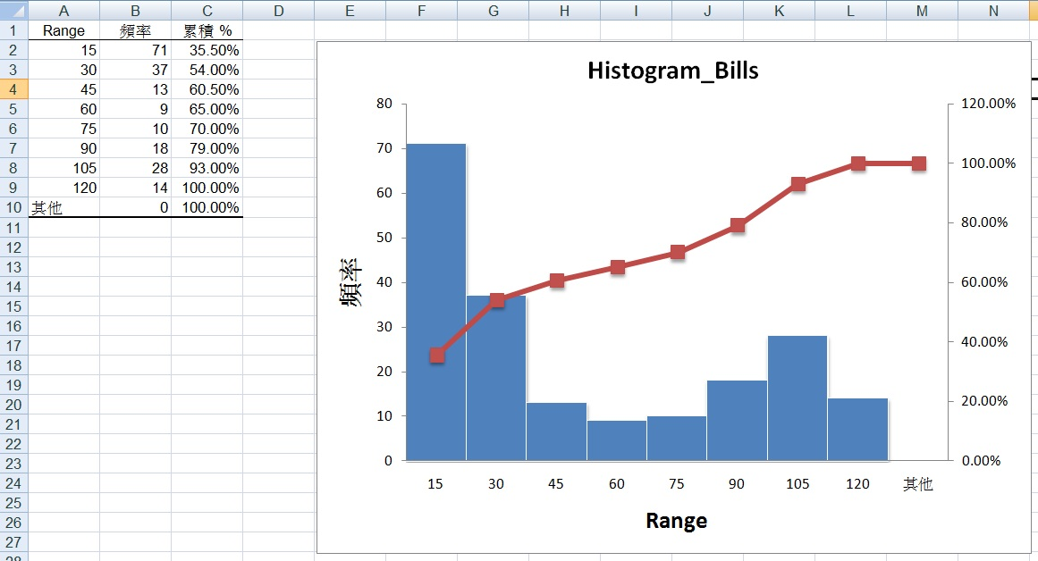
Excel Output

Slide 126
Apply Chebyshev
Mean = 43.58; Standard deviation = 38.9697.
Calculate the intervals:
Interval Chebyshev Empirical Rule Actual %
(4.62, 82.56) at least 0% 68% 60.5%
(-34.35, 121.527) at least 75% 95% 100%
(-73.32, 160.497) at least 89% 100% 100%

Slide 127
End of Chapter 4 Part A

Slide 128
Homework
Chapter 3:
3.31, 3.37, 3.51, 3.59, 3.73, 3.77
Chapter 4:
4.5, 4.15, 4.27, 4.31

Slide 129
Reason
He took a two dimensional space and managed to accurate depict five data variables: size of invading army, size of retreating army, geographic location, temperature, and time. The multivariate data is presented in such a way as to provide an intriguing narrative as to the fate of Napoleon’s army.

Slide 130
Size of Data
The graph presents large data set concisely and coherently
Small data sets are easily summarized with a table
One or two numbers can be presented in a sentence

Slide 131
Clearly Communicate
The idea and concepts to deliver are clearly understood by the viewers
An excellent chart is one that can replace a thousand words and be clearly comprehended by its readers

Slide 132
Encourage Comparison
Graphs are often best used to depict relationships between two or more variables or to explain how and why the observed results occurred.

Slide 133
The Substance of the Data
The form of graph is supposed to help present the substance of the data, not the other way around.

Slide 134
No Distortion
Cannot make statistical techniques say whatever you like.
Eventually, a reader will see through distortions and deception.

Slide 135
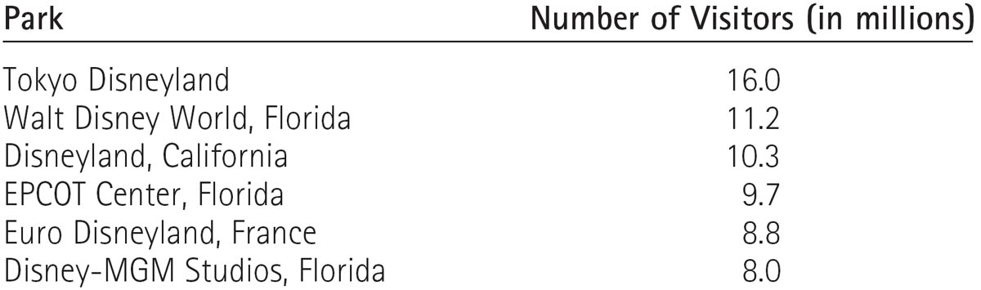
Number of People Visiting Disney Theme Parks in 1994

Slide 136
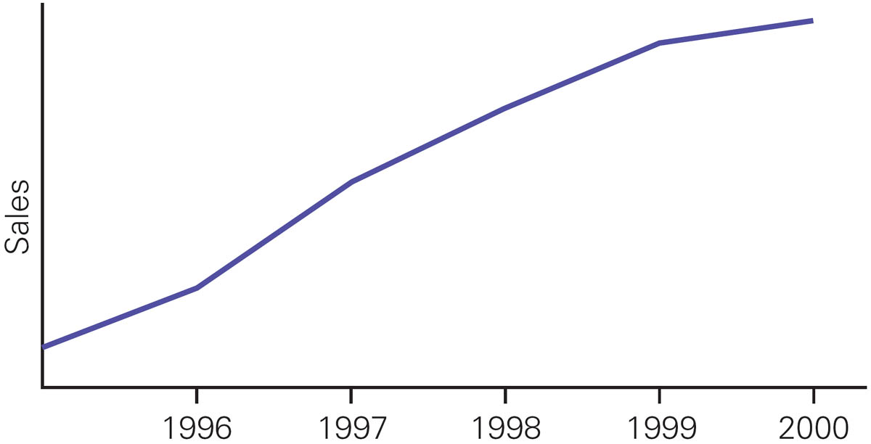
Without a Vertical Scale
There is a missing scale on one axis.
In $1000 or in units???

Slide 137
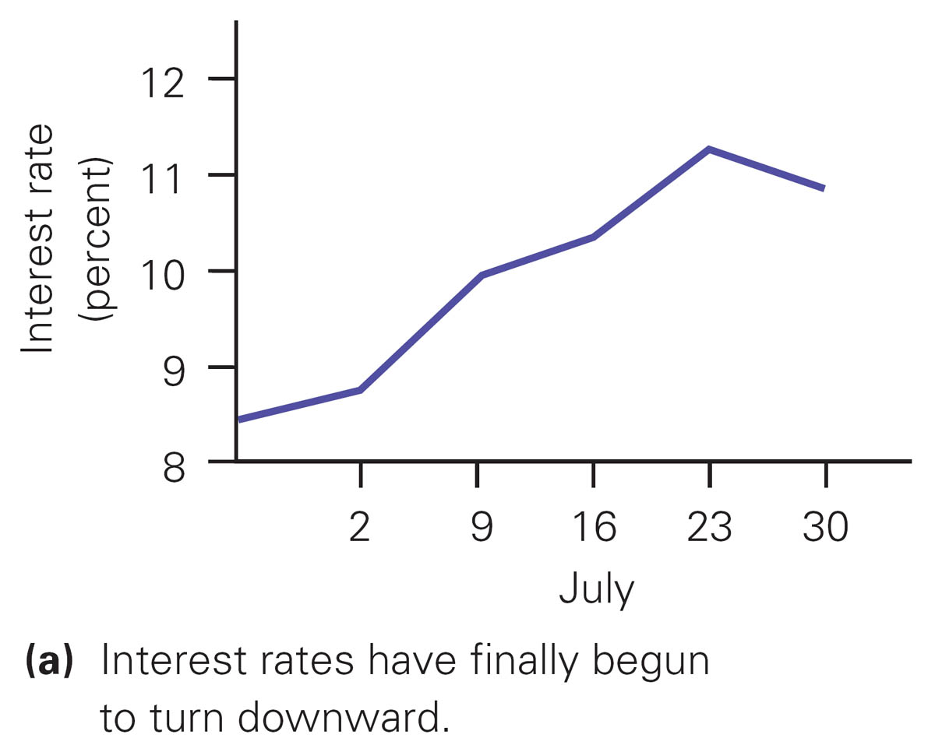
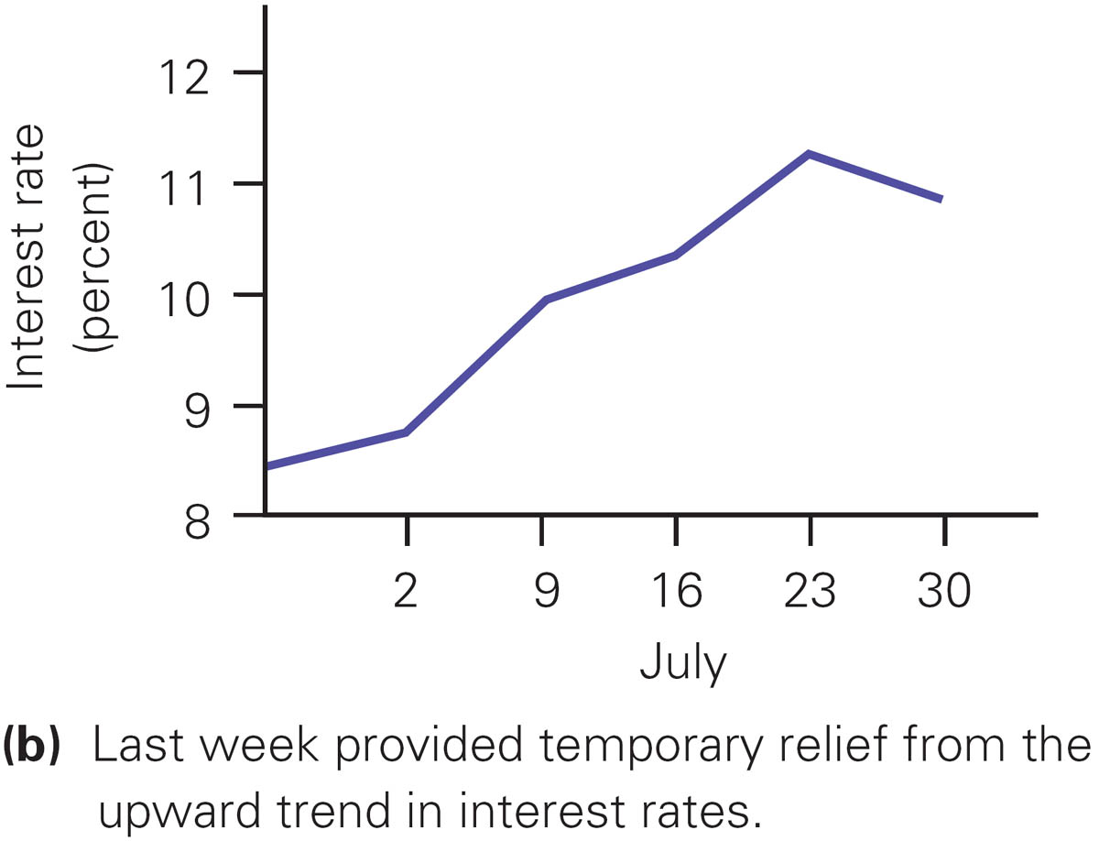
Different Captions
Which one do you believe?

Slide 138
Format of the Scales
Are changes presented in absolute values only, or in percent form too?
Sales
(3%)
120.0
(2%)
110.0
100.0
(1%)
Time

Slide 139
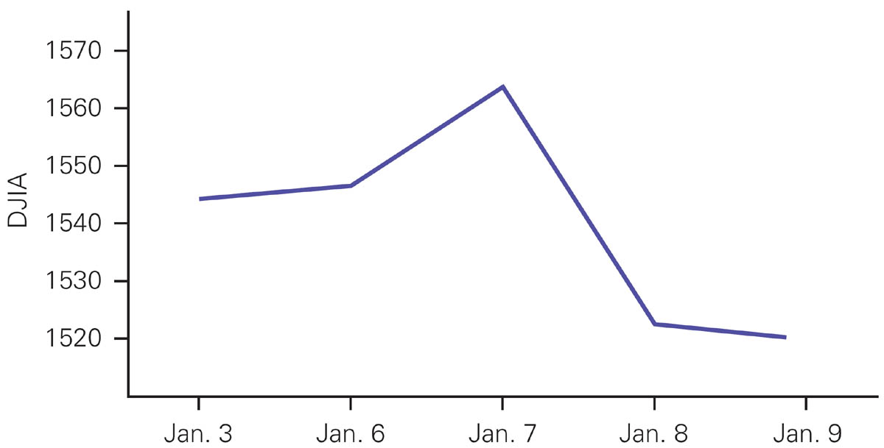
Historic Drop in DJIA, 1986

Slide 140
Stretching the Axis
Has any axis been stretched?
10%
Sales
Dollars
10%
Time
Aug. 98
Sept. 98
1980
1985
1990
Time

Slide 141
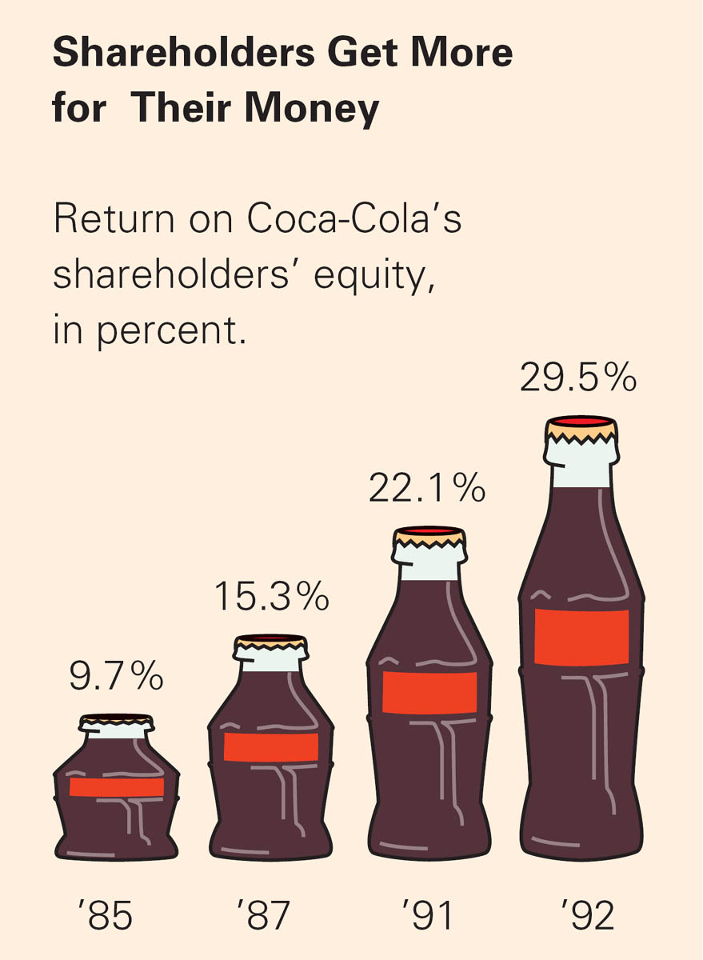
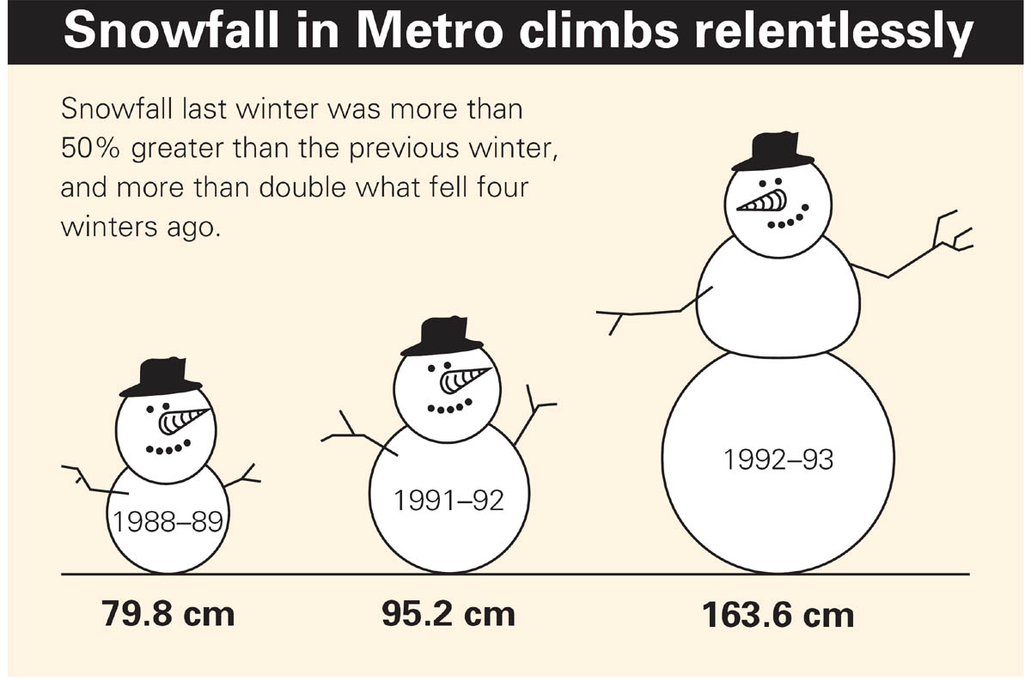
Incorrect and Correct Pictograms
√
×

Slide 142
Examples
Which data set has a larger dispersion?
Let us calculate the sum of squared deviations for both data sets
Data set B
is more dispersed
around the mean
However, when calculated on “per observation” basis (variance), the data set dispersions are properly ranked
A
B
1
2
3
1
3
σ_{A}² = Sum_{A}/N
= 10/10 = 1
5
Sum_{A} = (1-2)² +…+(1-2)² +(3-2)² +… +(3-2)²= 10
5 times
5 times
σ_{B}² = Sum_{B}/N
= 8/2 = 4
!
Sum_{B} = (1-3)² + (5-3)² = 8

